Slide 1
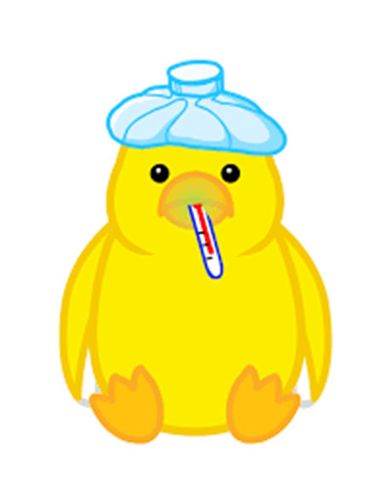
poultry diseases
fourth stage
شعار الكلية
Infectious Bronchitis +Infectious Laryngotracheitis
Dr.Harith Abdulla
Department of Pathology and Poultry Disease
College of veterinary medicine university of Basrah
University of Basrah- College of veterinary medicine- Department of Pathology and Poultry Disease

Slide 2
Infectious Bronchitis (IB)
Acute highly contagious , rapid spread respiratory viral disease of chickens , characterized by coughing , sneezing , gasping ,rales and nasal and ocular discharge . All ages are affected .
Etiology Coronavirus .
Incubation period : 18 – 36 hours { used in diagnosis } .
Course of disease :- 1– 2 weeks.
Method of spread :-
Airborne aerosol from infected bird .
Direct contact .
Contaminated premises .

Slide 3
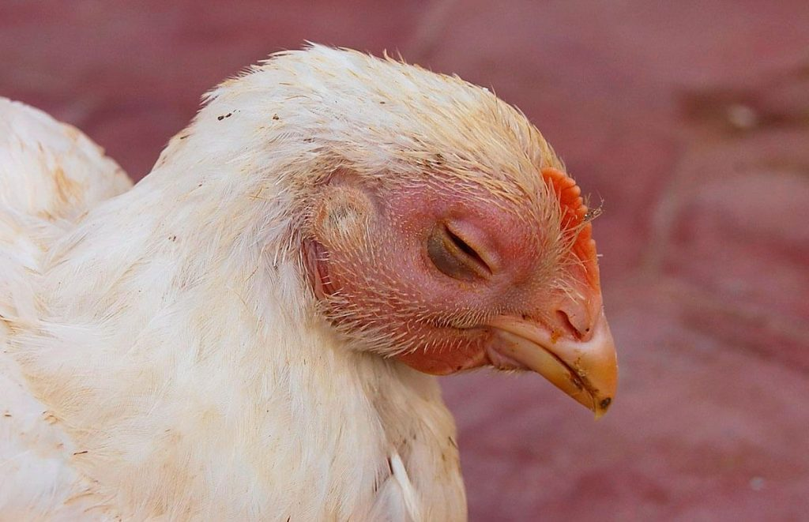
Clinical signs :
Chicks
Rales .
Wet frothy eyes with conjunctivitis and nasal discharge .
Swelling of infra-orbital sinus .
Depression and cold .
Increased feed conversion .
Swollen head syndrome .
B . Layers : Adult
Rales .
Seldom have nasal or ocular discharge .
Egg production may drop 20 - 25 % .
Soft , misshapen and rough surface of egg shells .
Inferior quality of egg contents(watery albumin).

Slide 4
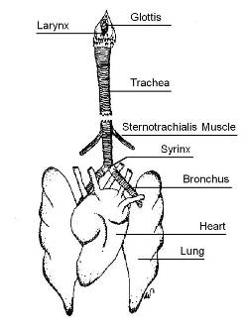
Post mortem lesions :
Chicks
Hyperemia of trachea .
Serous exudates in the trachea .
Slight airsacculitis .
Plugs at the tracheal bifurcation .
B . Layers : Adult
Tracheal hyperemia .
Serous and catarrhal exudates in the trachea.
Egg yolk peritonitis .
Salpingitis and damaged oviduct .
Swollen kidneys with urate deposition .

Slide 5
Diagnosis
History of fast spreading respiratory disease.
Signs .
Lesions .
ELISA .
Hemagglutination Inhibition test { HI} .
Virus Neutralization Test {VN} .
Isolation and identification of virus on embryonated eggs .
PCR { Polymerase Chain Reaction }
Experimental infection .
Differential diagnosis
All forms of respiratory diseases.

Slide 6
Treatment :-
No treatment .
Antibiotics to prevent secondary infections .
Increase temperature .
Prevention :
Vaccination
Progeny can be vaccinated at the first day of age .
Live vaccine
Killed vaccine:- Used in breeders and layers
to prevent production losses .

Slide 7
Types of IB Vaccines
Live Attenuated Vaccines (Mild & Intermediate strains)
Administered via spray, drinking water, or eye drops.
Provides short-term immunity, requiring booster doses.
Common strains: Massachusetts (Mass), Connecticut, Arkansas, 4/91, QX.
Inactivated (Killed) Vaccines
Given via intramuscular (IM) or subcutaneous (SC) injection.
Used in layers and breeders before laying for long-term immunity.
Recombinant Vaccines
Vector-based vaccines using viruses like HVT for early and long-lasting protection.
Often given in ovo (at hatchery) or at day-old via injection.

Slide 8
Common IB Vaccination Schedule
For Broilers (Short-Lived Birds)
Day 1: Live vaccine (Mass strain) via spray or eye drops.
Day 14–21: Booster (Mass or variant strain like 4/91).
For Layers & Breeders (Long-Lived Birds)
Day 1: Live vaccine (Mass strain) via spray or eye drops.
3–4 Weeks: Booster with another live strain (e.g., 4/91, QX).
6–8 Weeks: Another live booster (if needed).
10–12 Weeks: Inactivated vaccine (IM or SC) for long-term immunity.
16–18 Weeks: Second inactivated vaccine before laying.
During Laying: Live booster every 8–12 weeks based on risk.

Slide 9
Infectious Laryngotracheitis {ILT} {LT}
An acute , highly contagious disease of fowl , characterized by coughing , gasping and bloody expectoration .
Etiology: Herpesvirus .
Incubation period : 6 – 12 days .
Course of disease :- 10 – 14 days .
Morbidity : High
Mortality :- 5 – 70 % .
Method of spread :-
Contact .
Carrier for up to 2 years .
Mechanical transmission .
Wind transmission .

Slide 10
Clinical Signs
Most commonly occur in chicks over 5 weeks of age .
Sudden death with bloody beaks .
Swollen , watery eyes with moist rales , coughing and gasping .
Extended head with mouth breathing .
Bloody tracheal casts on equipment and house walls { Due to expectoration of blood}.
10 – 20 % decrease in egg production .
Slow spread .

Slide 11
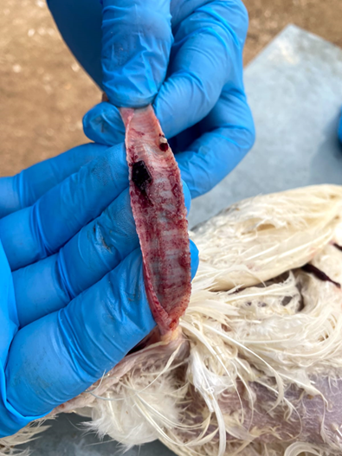
Post – mortem lesions
Edema and congestion of conjunctiva and infra-orbital sinus .
Blood and blood – tinged mucous in the trachea and larynx
In dead birds , cheesy cores may be in the trachea .
Diagnosis
History .
Signs{ Especially coughing with expulsion of blood}.
Gross lesion .
Histopathology :Intra-nuclear inclusion bodies.
Virus isolation .
Inoculation of suspected material into
susceptible chickens .
Differential diagnosis :-
All respiratory disease .

Slide 12
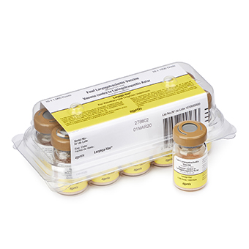
Treatment
No treatment .
Broad spectrum antibiotics to reduce secondary infection.
Prevention
Vaccination .

Slide 13
Vaccination
1. Live Attenuated (Modified Live) Vaccines
These vaccines contain a weakened ILT virus to induce immunity.
🔹 Tissue Culture Origin (TCO) Vaccine
Administration: Eye drop.
Use Case: Used in commercial layers and breeders.
Advantages: Lower virulence, minimal risk of spreading.
Disadvantages: Requires precise application (eye drop).
🔹 Chicken Embryo Origin (CEO) Vaccine
Administration: Eye drop, drinking water, or spray.
Use Case: Used in high-risk areas and during outbreaks.
Advantages: Stronger immune response.
Disadvantages: Can revert to virulence, may spread to unvaccinated flocks.

Slide 14
2. Recombinant ILT Vaccines
These vaccines use viral vectors (e.g., Herpesvirus of Turkey [HVT] or fowlpox virus) to deliver ILT antigens.
Administration: In ovo (embryo) or subcutaneous (SC) at day-old.
Use Case: Ideal for broilers, layers, and breeders in endemic areas.
Advantages: No risk of reverting to virulence, safer for large-scale use.
Disadvantages: Slower immune response than live vaccines.

